Slide 1
An improved Id3 algorithm for clinical data classification
-Data Mining
119003228 N.L.Veerendra
119003080 K.Gangadhar
119003107 P.Rohith Surya
Smt. Kamakshi

Slide 2
Paper:
Yang, Shuo, Jing-Zhi Guo, and Jun-Wei Jin. "An improved Id3 algorithm for medical data classification." Computers & Electrical Engineering 65 (2018): 474-487.
Url:
https://www.sciencedirect.com/science/article/pii/S004579061732517X

Slide 3
Introduction:
Improved Id3 algorithm for disease prediction
Features:
balance function for test attribute selection.
numeric attribute discretization strategy.
new rule-based heuristic method for classified representation.

Slide 4
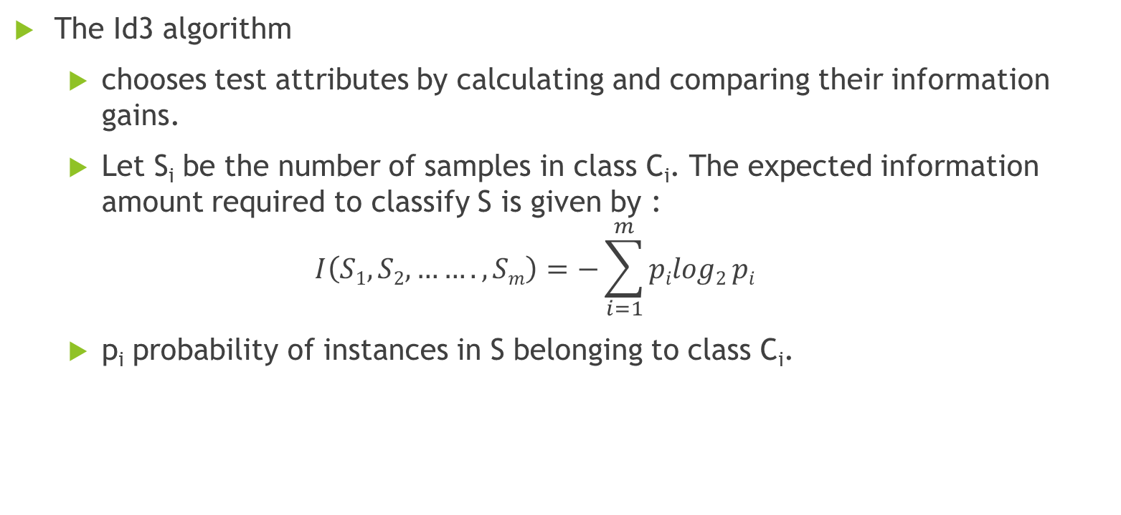
Basic principles of Id3
The Id3 algorithm
chooses test attributes by calculating and comparing their information gains.
Let S_{i} be the number of samples in class C_{i}. The expected information amount required to classify S is given by :
$$I\left(S1,S2,…….,Sm\right)=−\sum_{i=1}^{m}{pilog2}pi$$
p_{i} probability of instances in S belonging to class C_{i}.

Slide 5
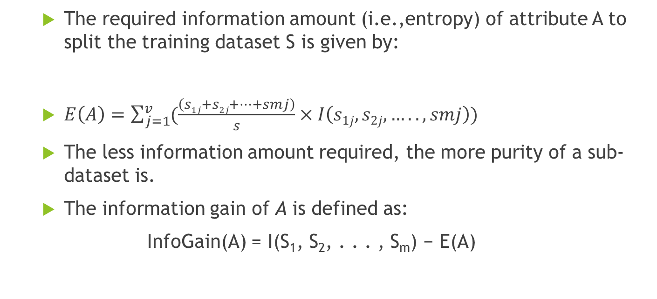
Basic principles of Id3
The required information amount (i.e.,entropy) of attribute A to split the training dataset S is given by:
$E\left(A\right)=\sum_{j=1}^{v}{(\frac{\left(s1j+s2j+…+smj\right)}{s}×I\left(s1j,s2j,…..,smj\right))}$
The less information amount required, the more purity of a sub-dataset is.
The information gain of A is defined as:
InfoGain(A) = I(S₁, S₂, . . . , S_{m}) − E(A)

Slide 6
Problems of classical Id3 algorithm
Bias on multi-variated attributes
The more different attribute values, the larger information gains.
Helplessness with numeric attributes
Clasical ID3 algorithm works only on nominal data.
if the default filter of NumericToNominal in WEKA is used to discretize the attributes, the performance of Id3 algorithm degrades dramatically.

Slide 7
Problems of classical Id3 algorithm
Loosing relations among attributes
uses a tree structure to represent a classifier model which is hard to interpret and understand.
the tree representation is neither an optimal method for storage nor a good way for interpretation.

Slide 8
Improvements on ID3
Balance Function
Discretization of numeric attributes
Rule representation of classifier model

Slide 9
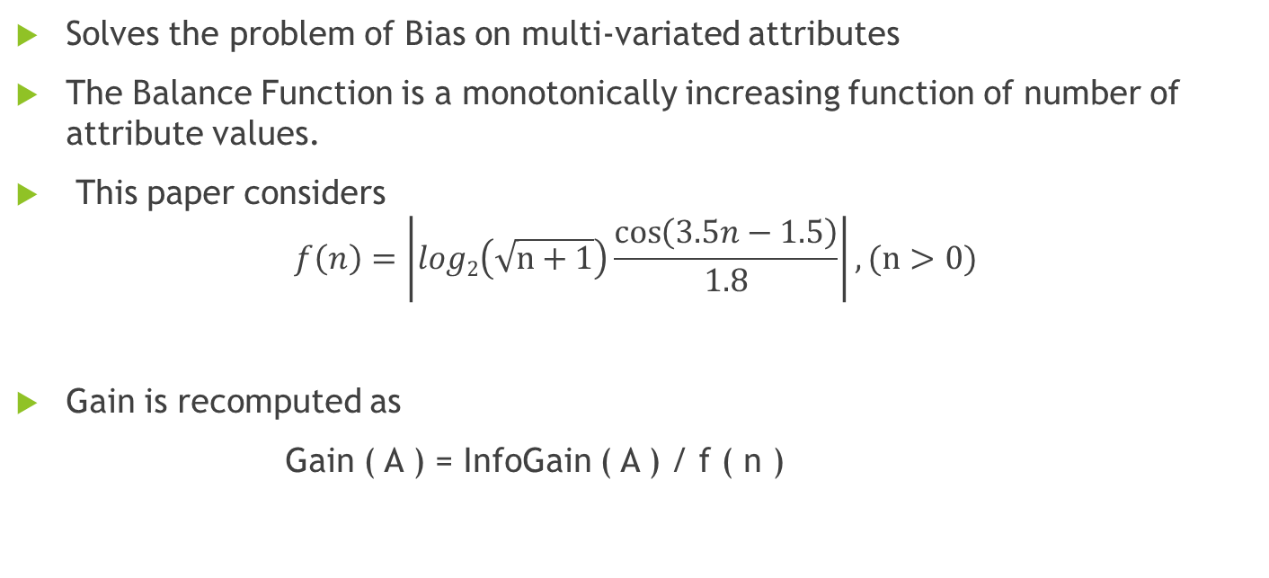
Balance Function
Solves the problem of Bias on multi-variated attributes
The Balance Function is a monotonically increasing function of number of attribute values.
This paper considers
$$f\left(n\right)=\left|log2\left(\sqrt{n+1}\right)\frac{\cos\left(3.5n−1.5\right)}{1.8}\right|, (n>0)$$
Gain is recomputed as
Gain ( A ) = InfoGain ( A ) / f ( n )

Slide 10
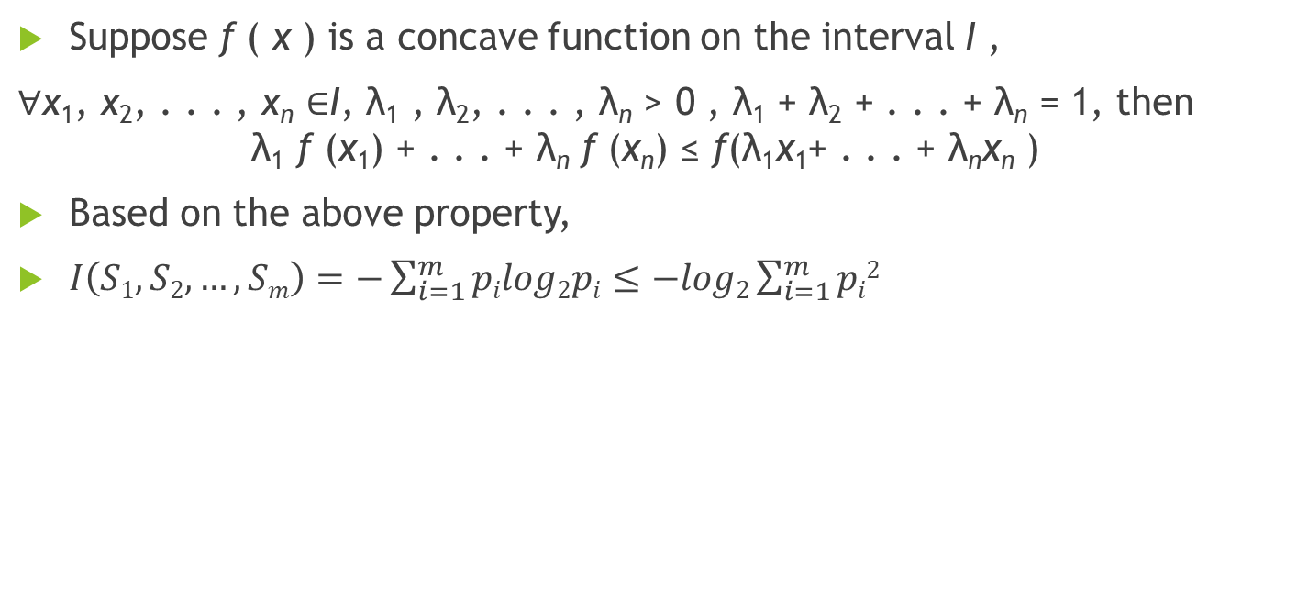
Discretization of numeric attributes
Suppose f ( x ) is a concave function on the interval I ,
$\text{∀}\text{x}\text{1}\text{, }\text{x}\text{2}\text{, . . . , }\text{x}\text{n} \text{∈}\text{I}\text{, }\text{λ}\text{1}\text{ , }\text{λ}\text{2}\text{, . . . , }\text{λ}\text{n} \text{> 0 , }\text{λ}\text{1}\text{ + }\text{λ}\text{2}\text{ + . . . + }\text{λ}\text{n} \text{= 1}$, then
$$\text{λ}\text{1} \text{f} \text{(}\text{x}\text{1}\text{) + . . . + }\text{λ}\text{n} \text{f} \text{(}\text{x}\text{n}\text{) ≤ }\text{f}\text{(}\text{λ}\text{1}\text{x}\text{1}\text{+ . . . + }\text{λ}\text{n}\text{x}\text{n} \text{) }$$
Based on the above property,
$I\left(S1,S2,…,Sm\right)=−\sum_{i=1}^{m}{pilog2pi≤−log2\sum_{i=1}^{m}{pi2}}$

Slide 11
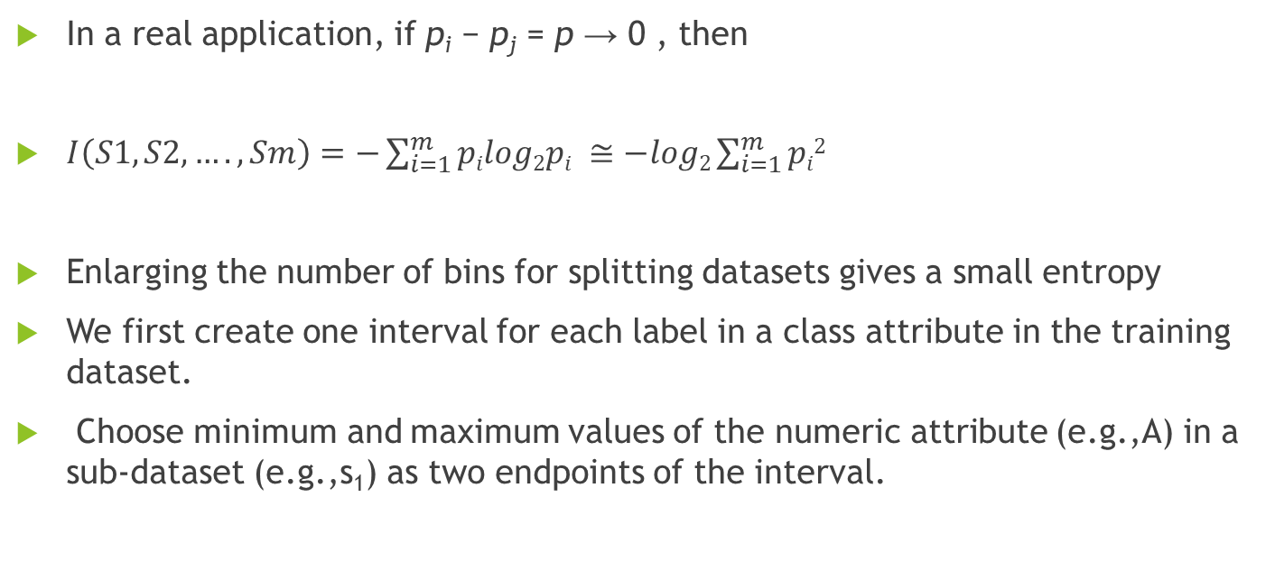
Discretization of numeric attributes
In a real application, if p_{i} − p_{j} = p → 0 , then
$I\left(S1,S2,….,Sm\right)=−\sum_{i=1}^{m}{pilog2pi ≅−log2\sum_{i=1}^{m}{pi2}}$
Enlarging the number of bins for splitting datasets gives a small entropy
We first create one interval for each label in a class attribute in the training dataset.
Choose minimum and maximum values of the numeric attribute (e.g.,A) in a sub-dataset (e.g.,s₁) as two endpoints of the interval.

Slide 12
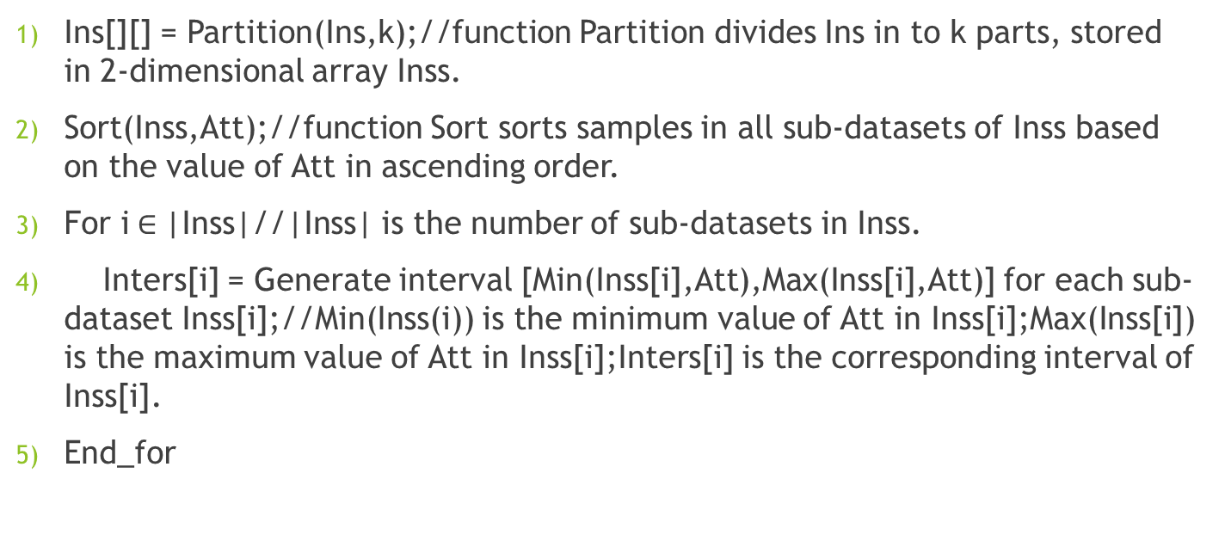
Algorithm to discretize a numeric attributes
Discretize(Ins,Att,k):Ins-training dataset; Att – a numeric attribute; k-the number of different labels in a class attribute.
Input: Att,Ins,k
Output: Intervals of Att
Ins[][] = Partition(Ins,k);//function Partition divides Ins in to k parts, stored in 2-dimensional array Inss.
Sort(Inss,Att);//function Sort sorts samples in all sub-datasets of Inss based on the value of Att in ascending order.
For i$∈$|Inss|//|Inss| is the number of sub-datasets in Inss.
Inters[i] = Generate interval [Min(Inss[i],Att),Max(Inss[i],Att)] for each sub-dataset Inss[i];//Min(Inss(i)) is the minimum value of Att in Inss[i];Max(Inss[i]) is the maximum value of Att in Inss[i];Inters[i] is the corresponding interval of Inss[i].
End_for

Slide 13
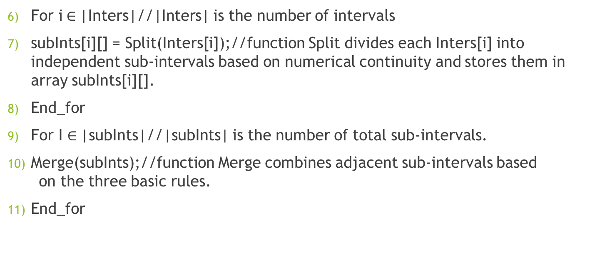
Algorithm to discretize a numeric attributes
For i$∈$|Inters|//|Inters| is the number of intervals
subInts[i][] = Split(Inters[i]);//function Split divides each Inters[i] into independent sub-intervals based on numerical continuity and stores them in array subInts[i][].
End_for
For I $∈$|subInts|//|subInts| is the number of total sub-intervals.
Merge(subInts);//function Merge combines adjacent sub-intervals based on the three basic rules.
End_for

Slide 14
Improved Id3 algorithm.
Id3_improved algorithm: Generate_Decision_tree( S , attribute list). S is a training dataset.
Input: training dataset; numeric class attribute is discretized before constructing a classifier model.
Output: a rule-based classifier model.
Create a node M
If all instances in a sub-dataset are in the same class (e.g. C), execute (3)
Return M as a leaf node and mark it with class C
If attribute list is empty, then execute (5)
Return M as a leaf node and mark it with the majority class in the dataset
If attribute list is not empty, then select an attribute with the greatest InfoGain/f(n) from the attribute list as a test attribute
Mark the node M as the test attribute
(8) If it is a numeric attribute, discretize it based on the class attribute values; Then execute (9)

Slide 15
Improved Id3 algorithm
For each value a i of the test attribute (e.g., A)
Regard A = a i as a testing condition and generate a corresponding branch from the node M
Let S i be the sub-dataset when A = a i
If S i is empty, then execute (13)
Add a leaf node and mark it with the majority class in the dataset
Else mark it with the return value of Generate_Decision_tree( S i , {new attribute list|{attribute list} −A })
Return rule-based decision list.

Slide 16
Rule representation of classifier model
TransformTreeToRules approach generates rule-based classifier models
representing rules as “IF...THEN ... ”.
Conjunction of all attribute-value pairs in the path constructs the IF part of the rule, while the class label in a leaf is the THEN part

Slide 17
Heuristic strategy
Heuristic strategy of four steps for rule pruning are used to shrink the size of the rulebase:
Step 1 : Supplement each rule with irrelevant values. Irrelevant values are the values of irrelevant attributes which can be deleted or replaced by any values from the same domain values without affecting the correctness of the rule.
Step 2 : If a rule ( e.g ., r₁ ) has n conditions in the head part and the former i conditions are different from other rules, then the latter (n−i+1) conditions can be deleted from r₁.
Step 3 : All rules are assigned to different groups in a decedent order according to the number of same conditions in the head part.
Step 4 : The set of rules is further reduced based on the MDL principle finding the shortest description of rules of the same group by dropping repeated conditions in their head parts.

